Slide 1
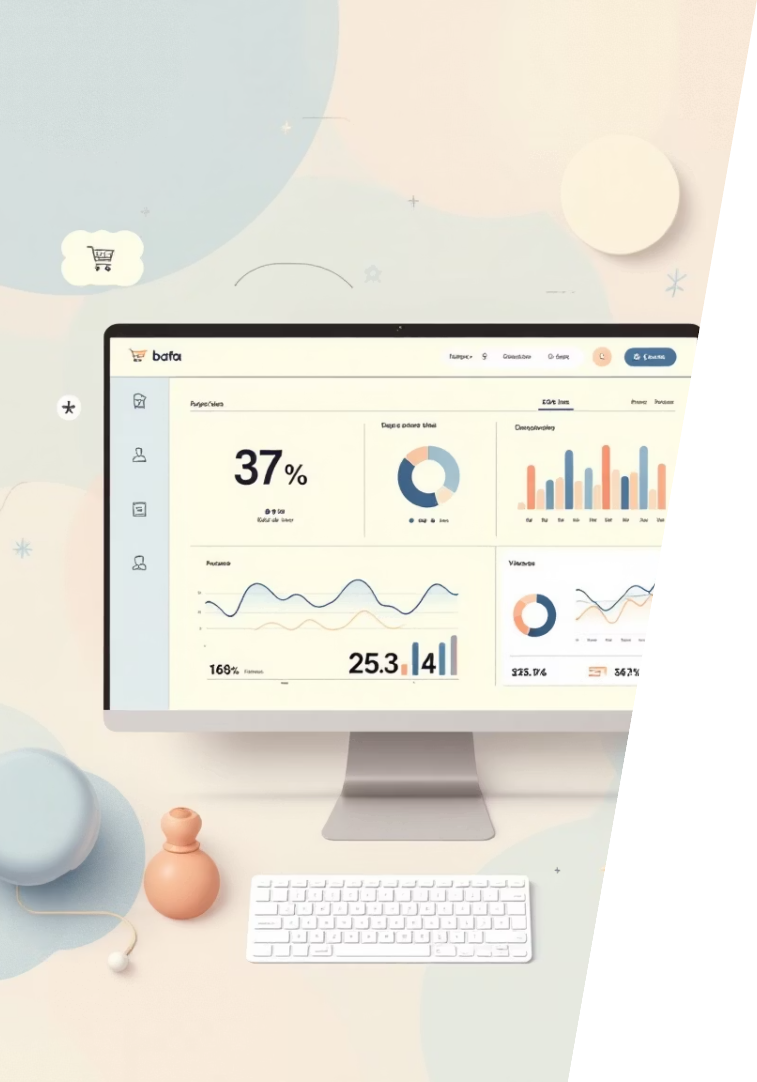
Customer Shopping Behavior Analysis
Insights from 3,900 Transactions to Drive Business Decisions

Slide 2
EXECUTIVE SUMMARY
Key Findings at a Glance
Dataset Scale
Revenue Drivers
3,900 customer transactions analyzed across demographics and purchase behavior
Gender, age group, shipping preference, and discount usage identified as key factors
Major Opportunities
Tools Used
Subscription conversion and targeted promotions show significant potential
Python, SQL (PostgreSQL), and Power BI for comprehensive analysis

Slide 3

Business Questions Addressed
01
Customer Segments
Which customer segments generate the most revenue?
02
Discount Impact
Do discounts drive higher-value purchases?
03
Product Performance
Which products and categories perform best?
04
Subscription Value
Are subscriptions increasing customer value and loyalty?

Slide 4

Dataset Overview & Preparation
Dataset Composition
Data Preparation
3,900 purchase records analyzed
Cleaned and standardized using Python (pandas)
18 demographic and transactional features
37 missing review ratings imputed using category medians
Customer data: age, gender, location, subscription status
Behavioral data: discounts, reviews, shipping type
Created age groups and purchase frequency features
Loaded into PostgreSQL for SQL analysis

Slide 5

Customer Demographics Insights
68%
44
Male Customer Base
Average Age
Male customers represent majority and generate ~2.1x more revenue
Average customer age across all segments
Young adults and middle-aged customers contribute the highest revenue. Significant opportunity exists to improve female customer engagement.

Slide 6

REVENUE DRIVERS
What Drives Higher Spending?
Express Shipping
Strategic Discounts
Combined Impact
Express shipping users spend ~3.5% more per order on average
839 discount users spend above average, indicating strategic discount potential
Revenue differences driven by both purchase frequency and order value

Slide 7

Product & Category Performance
Top-Rated Products
Customer favorites driving satisfaction and repeat purchases:
Gloves
Sandals
Boots
Hats
Skirts
Clothing category leads overall revenue and transaction volume. Discount-heavy products should be reviewed for margin impact.

Slide 8







Customer Segmentation & Subscription Analysis
Returning
Repeat buyers showing mixed subscription adoption
New Customers
First-time buyers entering the funnel
Loyal Segment
Large loyal segment indicates strong repeat behavior
27%
Subscribers represent 27% of customer base
Average spend between subscribers and non-subscribers is similar. Subscription value may lie more in retention than short-term revenue.

Slide 9
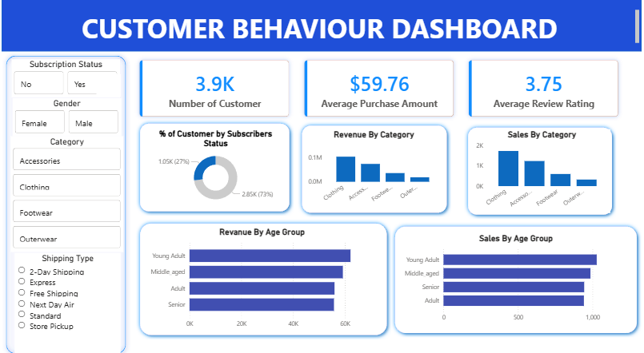
PowerBi Dashboard

Slide 10
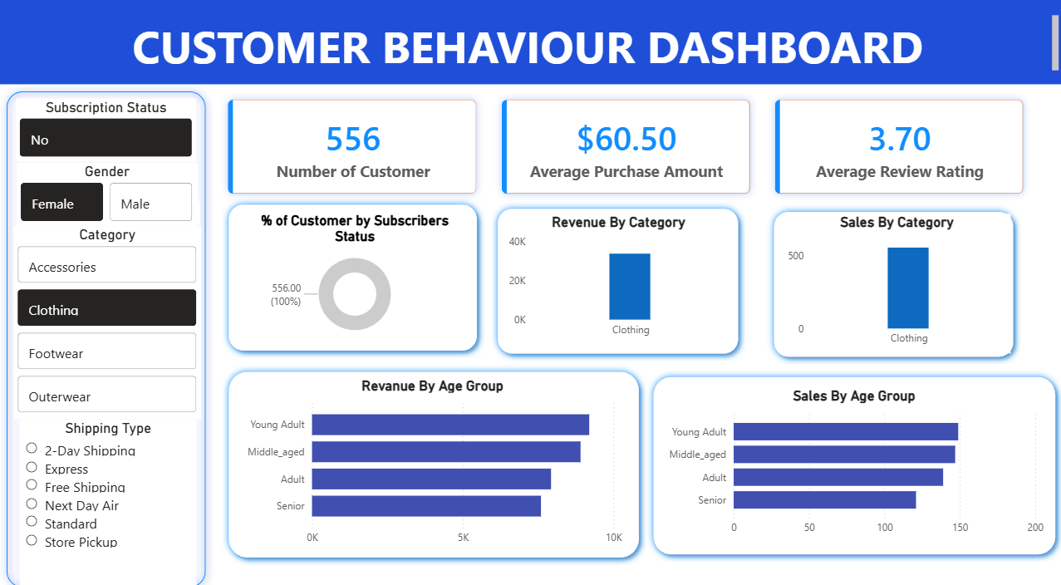
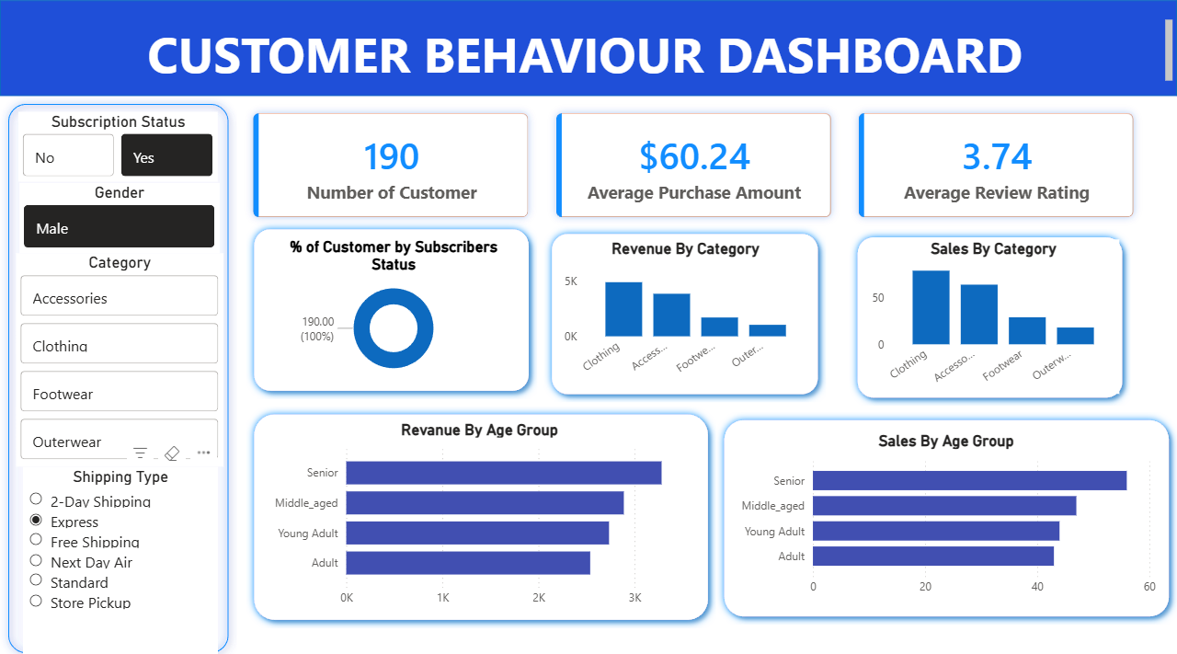
PowerBi Dashboard

Slide 11






RECOMMENDATIONS
Strategic Business Actions
Subscription Targeting
Target high-value non-subscribers with personalized subscription offers
Optimize Discounts
Focus discount usage toward high-spending customer segments
Promote Express Shipping
Increase average order value through express shipping promotion
Highlight Top Products
Feature top-rated products prominently in marketing campaigns

Slide 12

Limitations & Next Steps
Current Limitations
Future Work
Limited dataset size restricts long-term trend conclusions
Customer lifetime value modeling
No cost data available limits profitability analysis depth
Cohort analysis for retention patterns
Expanded dataset for deeper insights

